Slide 1
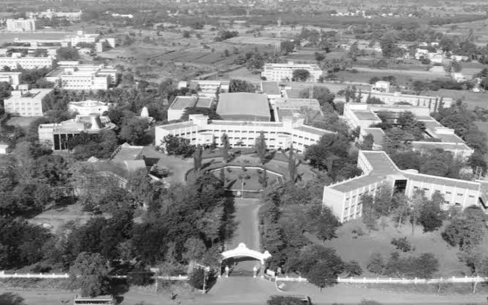



A.T.Ashok
B.Tech CSE Final Year
Arunai Engineering College
AI
(Artificial Intelligence)
Mouse

Slide 2


Problem Statement
In our laptops, sometimes touchpad are not functions properly. Because of touchpad are often using ,that will reduce the quality sensor.
And also our personal computer's mouse are not operate properly in the time of no full surface ground for mouse, any damages occurs in mouse wire ,and inbuild mouse some other issues,...etc

Slide 3

Solution:
These problems are facing everyone in modern day. For that I made coolest and advanced futuristic solution called Ai(Artificial Intelligence) Virtual mouse.
This Virtual mouse was fully developed by Python language with anaconda python.

Slide 4
Why I used python language ?
A python language is only supports many domain such as:
Artificial Intelligence
Cyber security
Web Development
Designing
Game development
Data Science
GUI development

Slide 5
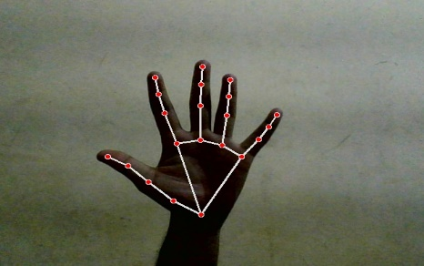
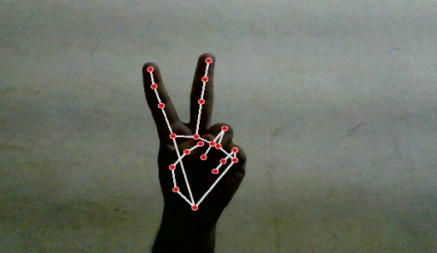
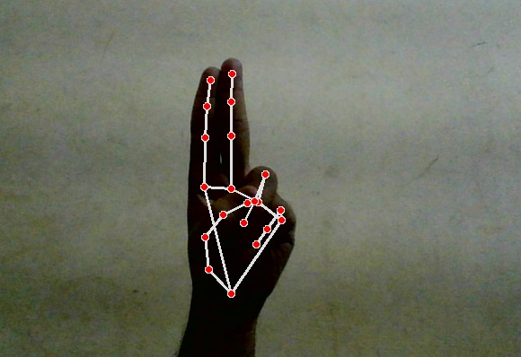
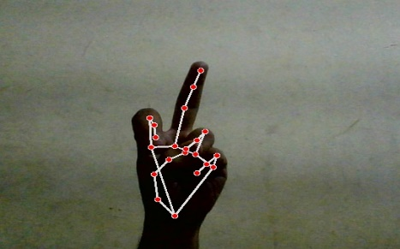
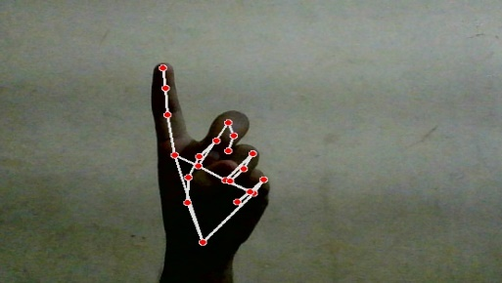
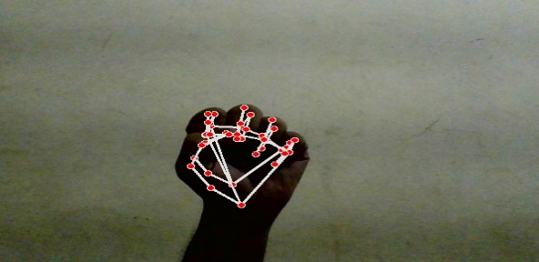
Some gestures of this Virtual mouse project:
No movement of Cursor
Cursor will be move
Double click
Left click
Right click
Multi select

Slide 6


Which platform I used to run the project?
Visual Studio Code
Specifically visual studio code python.
Visual Studio Code is a free source code editor that fully supports Python and useful features such as real-time collaboration. It's highly customizable to support your classroom the way you like to teach.

Slide 7

What is anaconda python?
Anaconda is a distribution of the Python and R programming languages for scientific computing.
Anaconda aims to simplify package management and deployment. The distribution includes data-science packages suitable for Windows, Linux, and macOS.
Benefit of using anaconda python is simplifies package management and deployment.

Slide 8
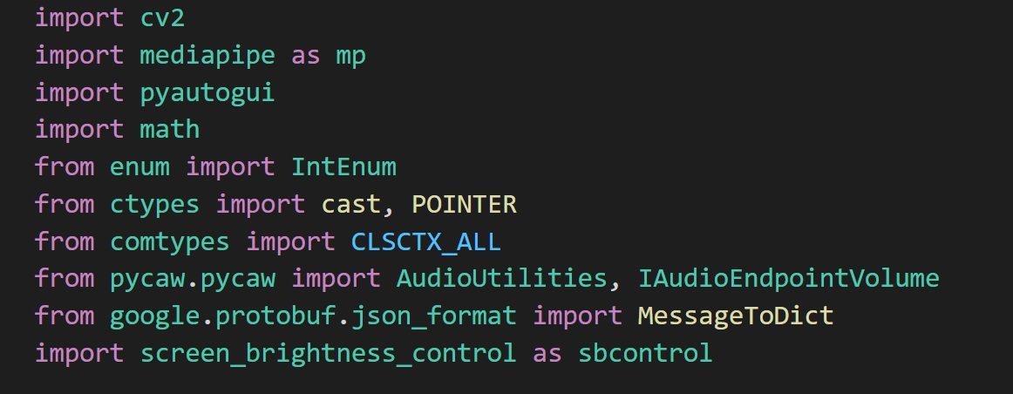
Put Your Screenshot
Here
These are the packages of Python used in the Project.
And then cv2 is the most important package in the Project.
Notes:
You can safely remove this slide. This slide design was provided by SlideModel.com – You can download more templates, shapes and elements for PowerPoint from http://slidemodel.com/

Slide 9

THANK YOU !!!

